Slide 1
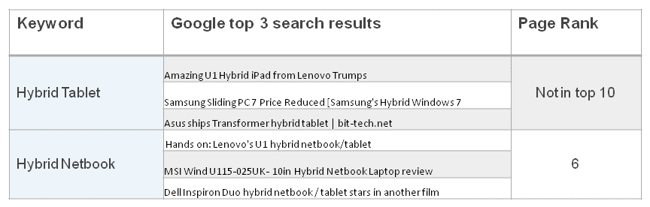
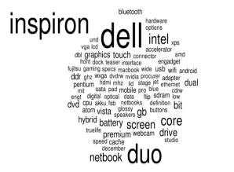

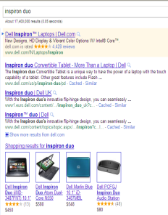
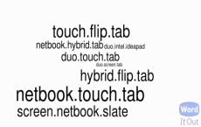
Commonly used buzz words for a product were identified for search optimization and better product marketing
Listening & Engagement - Buzzwords
Background
Insights/Recommendations
The client is a Fortune 500 technology solutions company with a wide portfolio of products and services
It has a strong presence in social media platforms such as Facebook, Twitter, blogs, forums
Mu Sigma helped the client identify commonly used buzz words associated with the clients product in the online social media space
Lists of single, pair and triads of buzz words were given to the search engine optimization team
Analytical Approach
Business Impact
From Radian6, identified single, pairs & triads of words creating buzz about a product for SEO
30% incremental traffic over the targeted keywords with 3% CTR was generated
Acquired traffic that was otherwise lost because of non-visibility in search engine results
Single
Pairs
Triads

